Slide 1
Programming Fundamentals Lecture #5 Principles of Structured and Modular Programming
Junaid Hassan
Lecturer CS & IT Department UOS MBDIN
junaidte14@gmail.com

Slide 2
Algorithms
Procedure for solving a problem by executing a series of actions and in a specific order is called an algorithm
In any algorithm, the order in which the actions are executed is very important
The order in which statements are executed in computer program is called program control

Slide 3
Pseudocode
Pseudocode is an artificial and informal language that helps you develop algorithm
Pseudocode Algorithms C Program
Pseudocode is written in a language similar to everyday English
It’s convinient and user friendly way to write code, although it’s not a computer programming language
Pseudocode actually helps us to ‘think out’ or ‘plan’ before attempting to write it a programming language
Pseudocode can be implemented in any programming language
Pseudocode consists only of action statments (definitions like int i are not added in pseudocode)

Slide 4
Control Structures
Statements in a program are executed one after the other in the order in which they’re written. This is called sequential execution
Sometimes the next statment to be executed may be other than the next one in the sequence, this is called transfer of control e.g goto statement
To write a program using transfer of control statements was difficult
New research revealed that all programs can be written with only three control structures namely sequence structure, selection structure, and the repetition structure
The sequence structure is the bulitin/default structure of C programming language i.e all statements by default execute one after the other in the order in which they are written

Slide 5
Control Structures
In C three types of Selection Structures are available namely, single selection statement (if statement), double-selection statement (if---else statement) and multiple-selection statement (switch statement)
In C three types of Repetition Structures (or loops) are available namely, while loop, do-while loop and for loop

Slide 6
If Selection Statement
Pseudodcode:
If student’s grade is greater than or equal to 60 Print “Passed”
C Code:
if ( grade >= 60 ) {
printf( "Passed\n" );
} /* end if */

Slide 7
If...else Selection Statement
Pseudodcode:
If student’s grade is greater than or equal to 60
Print “Passed”
else
Print “Failed”
C Code:
if ( grade >= 60 ) {
printf( "Passed\n" );
}
else {
printf( "Failed\n" );
}

Slide 8
Nested Control Structures
Nested if…else statements test for multiple cases by placing if…else statements inside if…else statements
C Code:
if ( grade != 60 ) {
if(grade > 60){
printf(‘Your grade is greater than 60’);
}else{
printf(‘Your grade is less than 60’);
}
}
else {
printf( “your grade is equal to 60" );
}

Slide 9
While Repetition Statement
A repetition statement allows you to specify that an action is to be repeated while some
condition remains true. It’s also called as counter controlled repetition. In this repetition we exactly know how many times the statements will be repeated.
Simple C program to print “Hello World” string 5 times
i = 0;
while ( i <= 4 ) {
printf(‘Hello World! \n’);
i = i+1;
}

Slide 10
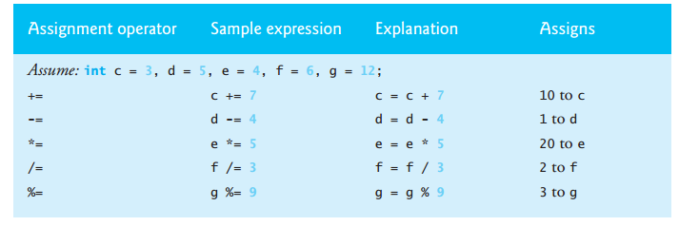
Assignment Operators
Used to assign values to the variable
c = c + 3;
or c += 3;

Slide 11
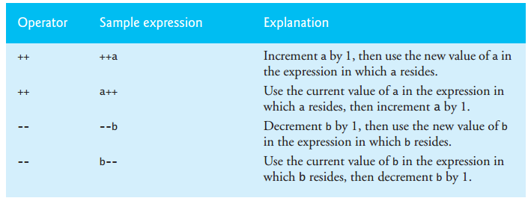
Increment and Decrement Operators
Increment Operator & Decrement Operators
Pre-Increment Operator, Pre-Decrement Operator
Post-Increment Operator, Post-Decrement Operator

